Slide 1

Uber's Real-Time Data Architecture: Engineering At Scale
A deep dive into how Uber processes millions of events per second to power real-time experiences for riders, drivers, and operations teams worldwide – from the data center to the street corner.

Slide 2

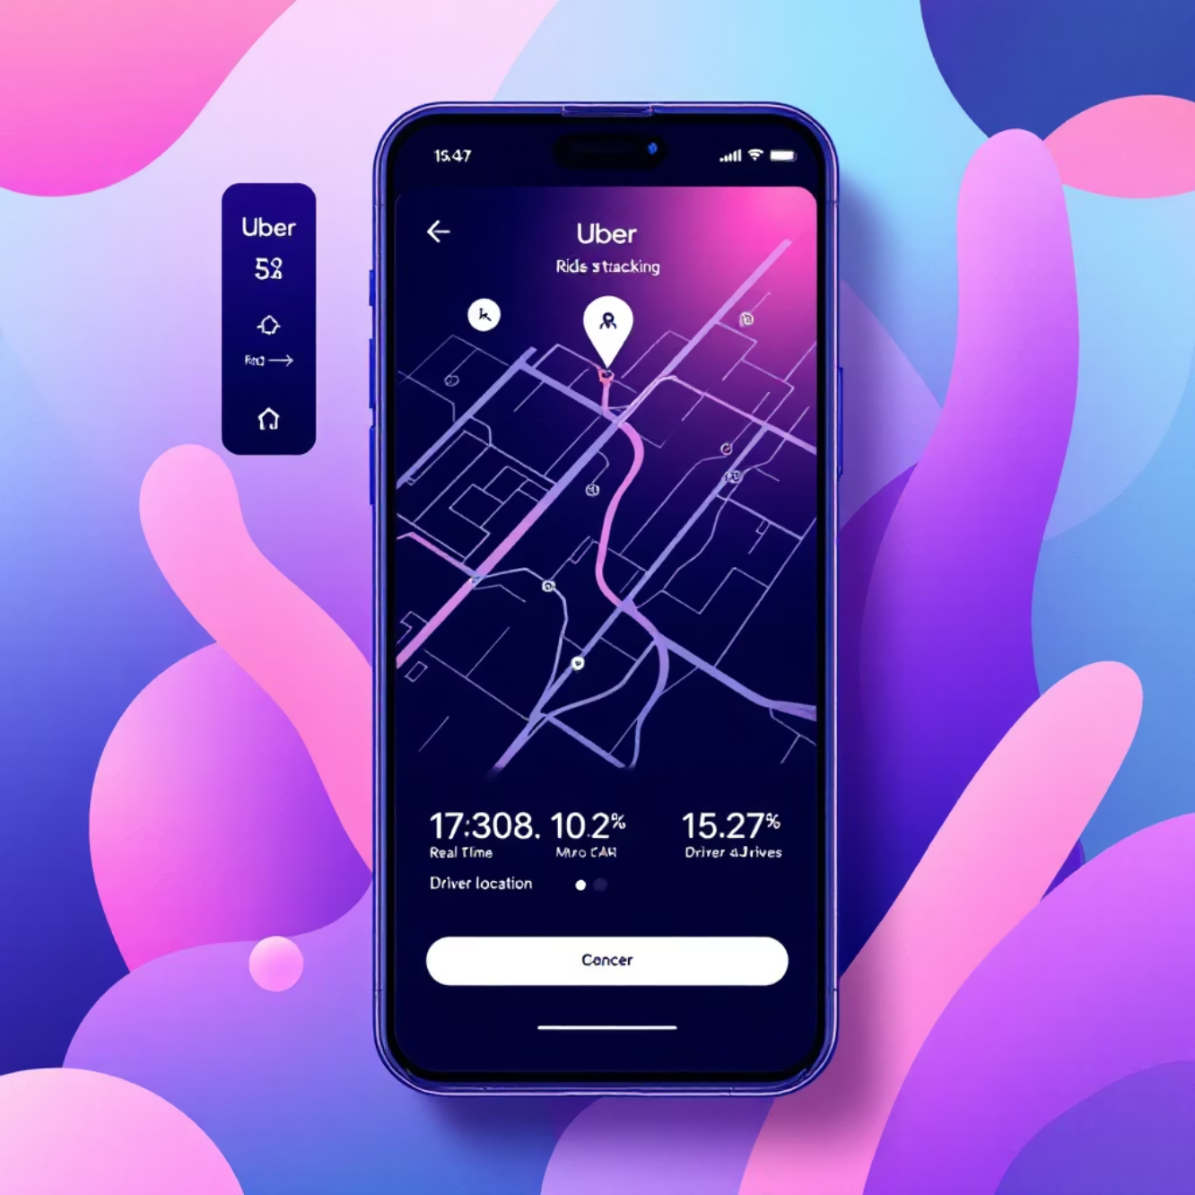

INTRODUCTION
The Challenge of Real-Time Data at Uber's Scale
Imagine orchestrating a massive symphony where every musician is a car or a passenger, and every note played is a tiny piece of information. Now, multiply that by millions of simultaneous performances in thousands of cities!
That's essentially the challenge Uber faces every day. Operating in over 10,000 cities with 183 million monthly users, Uber manages millions of trips daily. Each trip generates hundreds of real-time updates: GPS locations, pricing, driver availability, arrival estimates, and payments.
The system must instantly connect riders with drivers, calculate fare changes on the fly, track vehicles precisely, and process payments securely – all within milliseconds. Any tiny hiccup or delay would instantly impact your ride and Uber's operations.
Standard data systems, which update information only once an hour or day, simply can't keep up with this kind of constant, rapid flow. Uber needed to build a unique data platform capable of processing millions of events every second, with almost no delay, while remaining dependable, flexible, and affordable across its global network.

Slide 3






ARCHITECTURE OVERVIEW
The Layered Data Architecture
Think of Uber's data architecture like a bustling, interconnected city. Each layer plays a vital role in keeping everything running smoothly, from the roads to the city planning department.
Data Collection (Traffic Flow)
Real-Time Processing (Traffic Management)
Data Storage (City Records)
This layer is like the city's roads and sensors, capturing every piece of raw information — from rider requests to driver locations — as it happens, handling millions per second.
This acts as the city's memory, securely storing everything. Short-term records are available instantly, while long-term archives inform future planning.
This is the city's control room, instantly analyzing live data to calculate estimated arrival times, detect fraud, and adjust pricing for surge demand, keeping the city moving efficiently.
Data Delivery (City Services)
Analytics & ML (City Planning)
These are the city's essential services, providing immediate access to processed information. It powers your Uber app, internal dashboards, and fuels learning systems.
This layer is the city's planning department, using all the data to predict demand, optimize routes, and personalize experiences for riders and drivers, shaping the city's future.

Slide 4

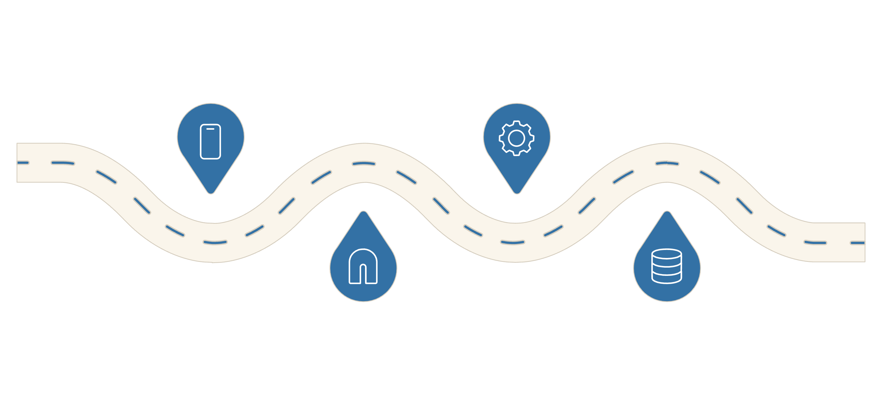




SYSTEM ARCHITECTURE
Uber's Real-Time Data Architecture: Complete System Flow
Explore the intricate journey of data through Uber's real-time infrastructure, from initial sources to user-facing applications, highlighting key components and latency at each stage.
STREAM PROCESSING
DATA SOURCES
Rider, driver, sensors, third-party APIs
Real-time engine: H3, matching, pricing, ML
INGESTION
STORAGE & APPS
API Gateway → Kafka → Collectors
Hot/Warm/Cold storage → Apps & analytics

Slide 5















ARCHITECTURE DEEP DIVE
Architecture Deep Dive: Understanding Each Layer
Let's peel back the layers of Uber's real-time data architecture to understand how each component contributes to a seamlessly efficient, global operation.
1. Data Sources
2. Data Ingestion
3. Stream Processing
Rider App: Every interaction generates data (location, requests).
API Gateway: Securely receives and routes all incoming requests.
Processing Engine: Analyzes data in real-time as it arrives.
Driver App: Status updates, availability, trip acceptance.
Message Queue (Kafka): Buffers incoming data to prevent loss during spikes.
Event Processing: Matches riders/drivers, calculates prices, determines routes.
Sensors & IoT: GPS, traffic, weather, vehicle telemetry.
Data Collectors: Standardize and normalize diverse data formats.
Aggregation & Windowing: Groups data by time and location (e.g., H3 hexagons).
Third-party APIs: Maps, payments, external services.
Key Point: Ensures data integrity and organization before processing.
ML Models: Predicts demand, detects fraud, forecasts traffic.
Key Point: Millions of these events happen simultaneously across the globe.
Key Point: All decisions happen in 10-50 milliseconds—faster than you can blink.
4. Data Storage
5. Applications & Use Cases
Hot Storage (Redis): Fastest for current, frequently accessed data.
Rider App: Shows drivers, ETA, pricing, trip status.
Warm Storage (Cassandra): Recent data (last 24 hours) for quick access.
Driver App: Trip offers, navigation, earnings, ratings.
Operations Dashboard: Real-time monitoring of system health and demand.
Cold Storage (S3): Historical data for analytics and machine learning.
Analytics & Insights: Business intelligence, trend analysis.
Real-time Database: Optimized for instant queries and updates.
Fraud Detection: Identifies and blocks suspicious transactions.
Key Point: Different data "temperatures" require optimized storage solutions.
Key Point: All applications benefit from instant, accurate data from the system.
Data Journey Example: Rider Request
Follow a single rider's request through Uber's architecture:
1. Rider opens app in NYC: Location sent to API Gateway.
2. Data enters Kafka queue: Ensures reliable ingestion.
3. Stream processor receives data: Analyzes location + demand.
4. H3 system identifies: Rider's precise geographic hexagon.
5. Matching algorithm: Searches for the nearest available driver.
6. Pricing engine: Calculates surge pricing based on real-time demand.
7. Results stored in Redis: Hot storage for instant access.
8. Rider app receives match: Driver match in less than 200ms.
9. Driver app notified: Receives trip details.
10. Trip data archived: Sent to cold storage for future analytics.
Why This Architecture Matters
Speed
Reliability
Scalability
Decisions made in milliseconds, not hours, for instant user experiences.
No data loss, even during peak loads or system failures.
Handles millions of events per second and grows with demand.
Flexibility
Cost-Effective
Easy to integrate new features and support evolving use cases.
Tiered storage and efficient processing reduce operational expenses.
Technologies Behind Uber's Real-Time Architecture
Data Ingestion & Streaming
Apache Kafka: Distributed message broker for handling millions of events per second
gRPC: High-performance RPC framework for inter-service communication
Protocol Buffers: Efficient data serialization format
Stream Processing
Apache Flink: Real-time stream processing engine for complex event processing
Apache Spark Streaming: Batch and stream processing
Uber's custom frameworks: Built on top of open-source tools for specific needs
Data Storage
Redis: In-memory data store for hot storage (sub-millisecond latency)
Apache Cassandra: Distributed NoSQL database for warm storage (high throughput, fault-tolerant)
Amazon S3 / HDFS: Object storage for cold storage (historical data, archives)
Elasticsearch: Full-text search and analytics for logs and events
Databases & Query Engines
Uber's Ringpop: Distributed hash ring for consistent hashing
Uber's Schemaless: Custom database for flexible, scalable data storage
Presto: Distributed SQL query engine for analytics
Machine Learning & Analytics
TensorFlow / PyTorch: Deep learning frameworks for demand prediction and fraud detection
Uber's Michelangelo: ML platform for building, deploying, and managing ML models at scale
Apache Spark MLlib: Machine learning library for large-scale ML
Monitoring & Observability
Uber's Ringpop: Service discovery and health checking
Prometheus: Metrics collection and monitoring
Jaeger: Distributed tracing for debugging and performance analysis
ELK Stack (Elasticsearch, Logstash, Kibana): Log aggregation and analysis
Infrastructure & Deployment
Kubernetes: Container orchestration for managing microservices
Docker: Containerization for consistent deployment
Uber's Uberflow: Custom workflow orchestration system
These technologies work together seamlessly to process millions of events per second with sub-200ms latency, ensuring reliability, scalability, and performance at global scale.

Slide 6

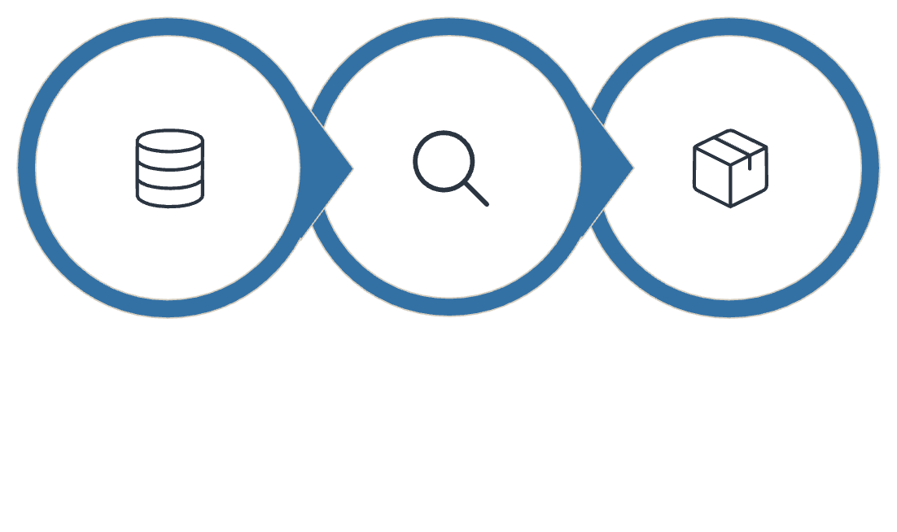


CORE TECHNOLOGY
Apache Kafka: The Nervous System of Uber's Data Platform
Imagine Uber's operations as a vast network of interconnected systems, like the human body. Apache Kafka acts as the central nervous system, relaying critical information – every ride request, driver location, and payment transaction – across the entire organization in real time. It's the technology that ensures all parts of Uber's digital city communicate instantly and reliably.
Capture
Stream
Deliver
This allows different services to seamlessly "talk" to each other without complex direct connections. For instance, a rider requesting a trip (a "producer") sends a message into Kafka. The system instantly routes this message to various "consumers" – like the driver dispatch system, the ETA calculator, and fraud detection algorithms – all without the rider's app needing to know about each one individually.
Speed
Reliability
Handles millions of messages per second with minimal delay, crucial for real-time pricing and ride matching.
Ensures no data is lost, even during system outages, by safely storing and replicating every piece of information.
Scalability
Flexibility
Grows effortlessly with Uber's expanding data volume, allowing more rides and users without performance drops.
Decouples different services, allowing teams to innovate and deploy updates independently.
Key Impact: Uber's Kafka clusters process over 1 trillion messages daily, supporting critical functions from dispatching rides to powering predictive AI models, with peak throughput exceeding 10 million messages per second during busy hours.
Kafka is engineered to handle massive amounts of real-time data, like a constant news broadcast for all of Uber's systems. This allows for instant updates across the platform, from showing you the exact location of your driver to instantly processing your payment. This constant, reliable flow of information is what enables Uber to deliver a smooth and responsive experience for millions of users worldwide.

Slide 7

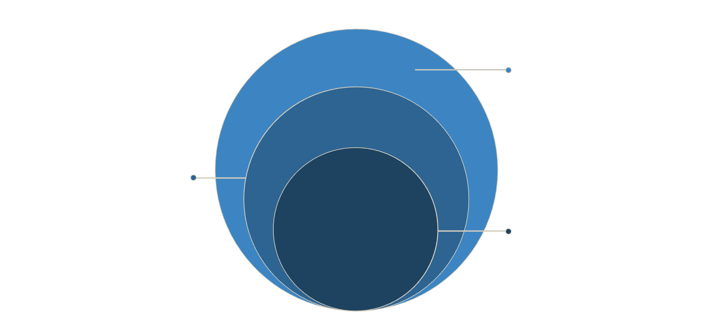
GEOSPATIAL INNOVATION
H3: The Honeycomb City – Dividing the World into Smart Hexagons
Imagine if you could divide the entire Earth into perfectly organized honeycomb-shaped pieces, like a beehive stretched across the globe. That's exactly what Uber's H3 (Hexagonal Hierarchical Spatial Index) does – and it's one of the most clever innovations powering your ride.
Street-Level Cells
Small hexes for fine-grained data
City-Block Level
Large hexes covering neighborhoods
H3 Core
Hexagonal spatial indexing system
Why Hexagons? The Honeybee's Secret
How It Works: Your City as a Honeycomb
Bees are nature's master architects, and Uber learned from them. Hexagons are superior to squares or triangles because:
Think of your city divided into thousands of hexagonal "cells" of different sizes:
Equal Distance to Neighbors: Every center point of a hexagon is the same distance from all six neighbors, making calculations fair and accurate.
Zoom Out: Large hexagons show entire neighborhoods – great for planning driver availability across a region.
Zoom In: Tiny hexagons pinpoint individual street corners – perfect for knowing exactly where to pick you up.
No Empty Spaces: Hexagons fit together perfectly without gaps, covering every inch of a city.
Smart Grouping: Smaller hexagons nest inside larger ones, creating a hierarchy like folders on your computer.
Natural Fit: They better represent real-world areas and minimize distortion, especially near Earth's poles.
Unique IDs: Every hexagon gets a unique code, making it lightning-fast to find patterns and make decisions.
Efficient Analysis: Perfect for understanding patterns like where riders are waiting or traffic is building up.
Dynamic Pricing (Surge)
Optimal Driver Positioning
H3 analyzes demand in each hexagon. If a concert just ended, that specific area's hexagons light up with high demand, triggering smart price adjustments only where needed – not the entire city.
The system identifies which hexagons will have high demand in the next 10 minutes and suggests drivers move there proactively, reducing wait times for everyone.
Precise ETAs
Geofencing Made Simple
By tracking how long trips take between specific hexagons at different times, Uber predicts your arrival time with remarkable accuracy.
Airport pickup zones, restricted areas, and service boundaries are defined by groups of hexagons, making them easy to update and enforce.
Real-World Impact: During a major event like a stadium concert, H3 allows Uber to monitor demand at 15 different resolution levels simultaneously – from the entire stadium district down to individual entry gates – adjusting in real-time to get everyone home safely and efficiently.
This honeycomb approach, open-sourced by Uber for anyone to use, transforms how we understand and organize geographic information, making Uber's marketplace intelligent enough to anticipate your needs before you even open the app.

Slide 8
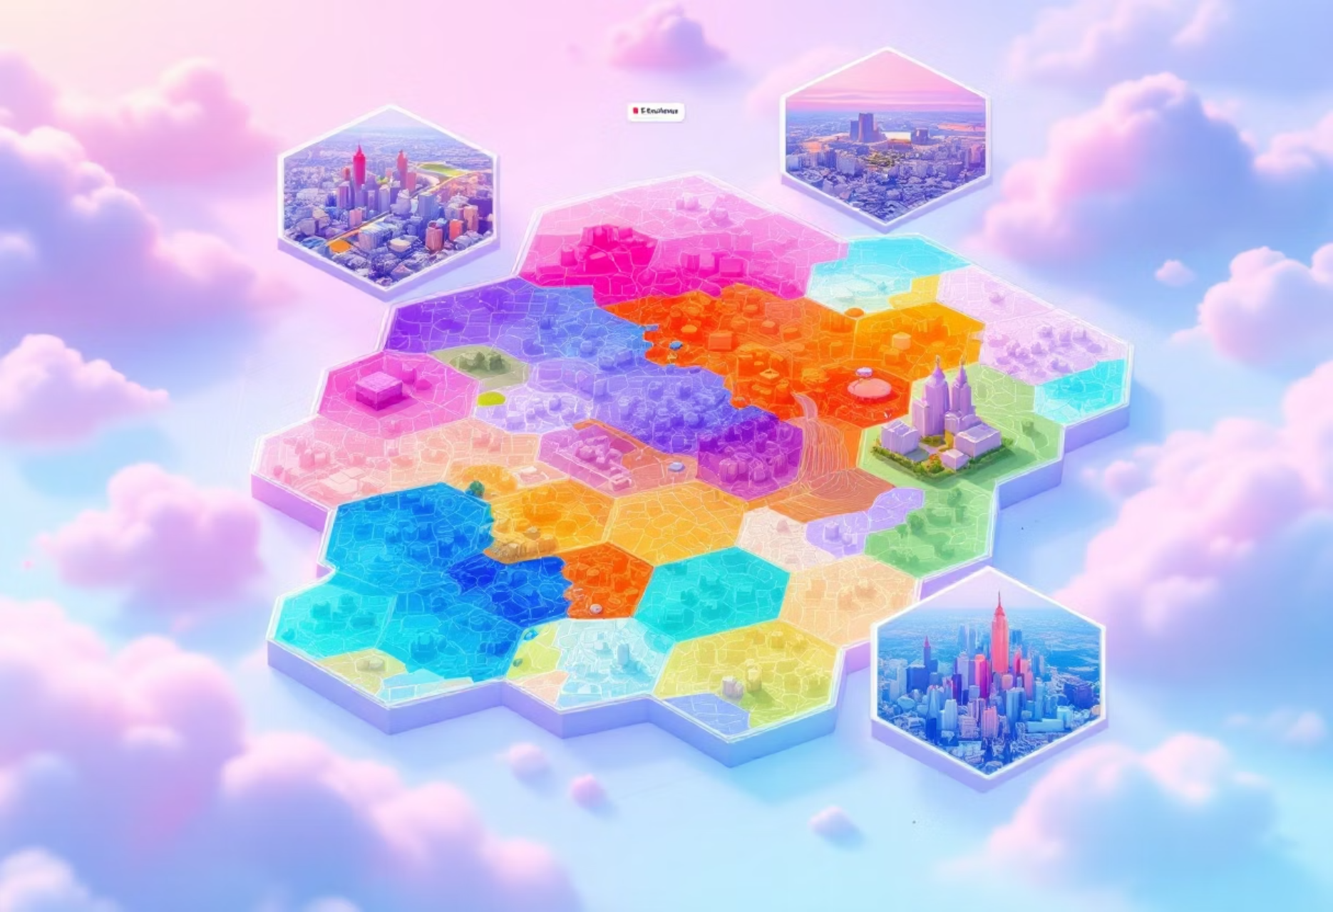
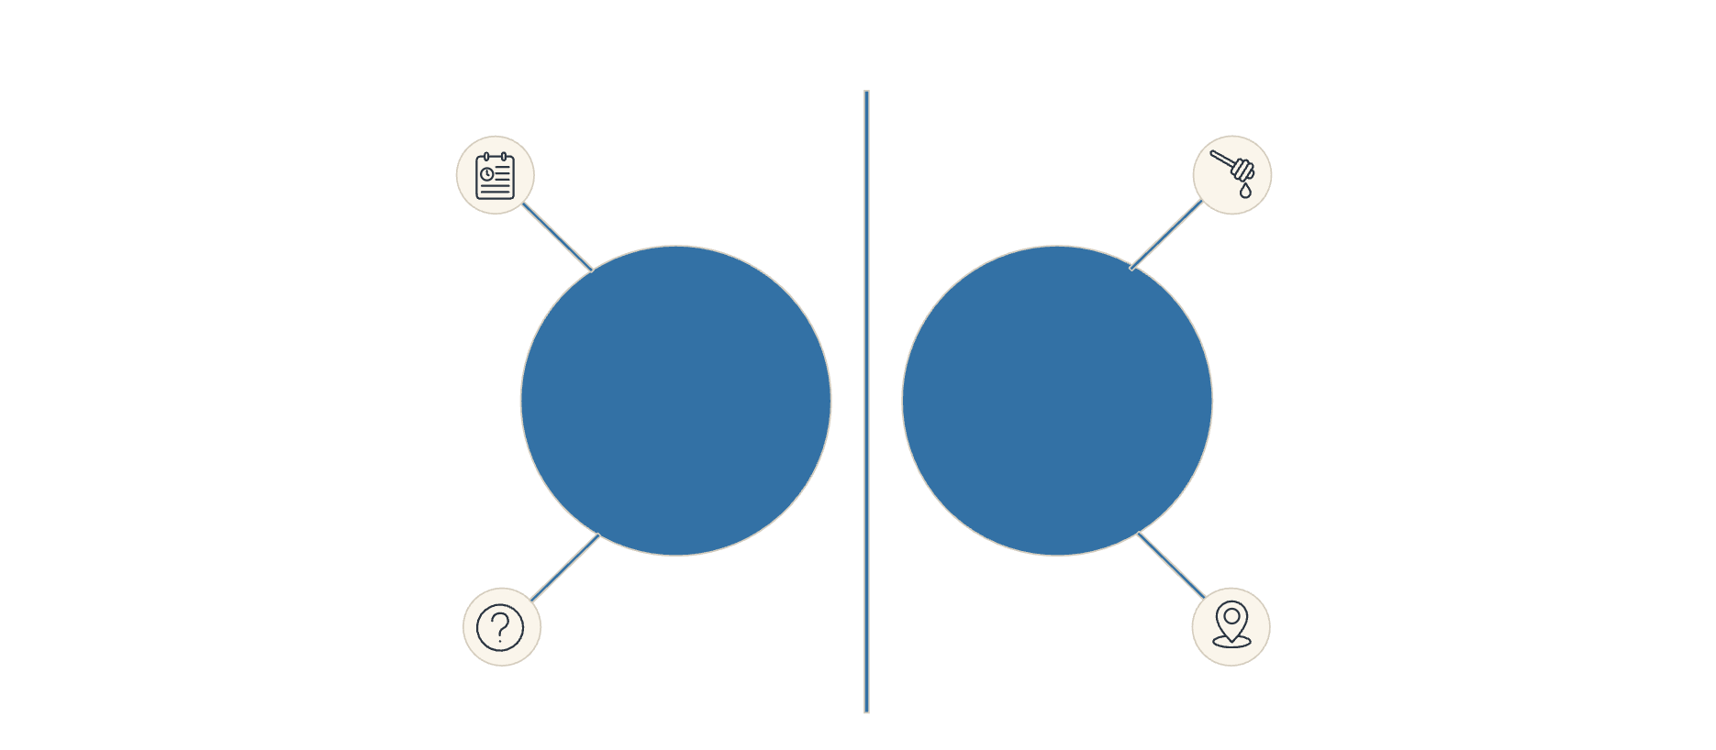



GEOSPATIAL INNOVATION
H3 Hexagons Explained: Think of Your City as a Honeycomb
Uber's H3 system divides the world into a vast, organized grid of hexagonal cells. Imagine your entire city, from every street corner to every park, covered in these perfectly interlocking honeycombs. This smart grid helps Uber understand and optimize movement across urban landscapes like never before.
Why Hexagons Beat Squares: The Geometry Lesson
The Gap Problem with Squares
When you try to cover a curved surface, like our Earth, with square tiles, you run into a problem: they don't fit perfectly. Imagine trying to wrap a basketball with square tiles – you'll inevitably end up with awkward gaps at the corners and frustrating overlaps at the edges. This creates inaccuracies when trying to analyze data or define locations, as a single point might fall into a gap or ambiguously belong to multiple squares.
Why Hexagons Are Perfect
Unlike squares, hexagons are nature's design for perfect tessellation – meaning they fit together with zero gaps and zero overlaps. Think of a honeycomb in a beehive, or the patterns on a soccer ball; everything fits perfectly. This is crucial for consistent data analysis. What's more, every hexagon has six immediate neighbors, and the distance from the center of any hexagon to the center of any of its neighbors is always equal. This property ensures fair and accurate calculations for all areas, regardless of their position on the grid.
Real-World Impact on Uber's System
This geometric advantage has a significant impact on Uber's operations. For example, with a square grid, a rider standing exactly at the corner of four squares might be ambiguously assigned to the wrong zone, leading to inefficient matching or pricing. With hexagons, every single location clearly and unequivocally belongs to exactly one hexagon, eliminating ambiguity. This precision is vital when calculating distances between zones or predicting demand, as hexagons provide consistent, accurate results every time, making the entire system more reliable and efficient.
Gap problem at corners
Perfect tessellation
Square Grid
Hexagonal Grid
Ambiguous point assignment
Clear point inside cell

Slide 9




Real-World Impact: The Concert Rush
Consider a large concert letting out at a stadium. H3's dynamic grid helps Uber manage this surge in real-time:
Event Detection
Demand Surge
The H3 system recognizes the stadium area as a collection of hexagons. As the concert nears its end, sensors and predicted activity signal an upcoming surge.
Specific hexagons around the stadium quickly "light up" in orange or red, indicating a massive spike in ride requests. Other areas remain 'blue' for low demand.
Driver Deployment
Smart Pricing
Uber's platform uses this H3 data to instantly direct available drivers to these high-demand hexagons, minimizing passenger wait times and ensuring efficient pickups.
Pricing adjustments are localized to just those specific high-demand hexagons, rather than the entire city, making surge pricing fairer and more targeted.
This intelligent, hexagon-based approach ensures that whether you're at a major event or just heading home, Uber can efficiently connect you with a ride, making urban mobility smarter and more responsive.

Slide 10






GEOSPATIAL TECHNOLOGY
H3 Geospatial Index: Architecture, Technology & Real-World Implementation
Understanding Uber's H3 system requires delving into its core architecture, the technologies that power it, and its practical application across Uber's ecosystem. This section provides a comprehensive technical overview, illustrating how raw location data is transformed into actionable intelligence.
H3 System Architecture Overview
INPUT LAYER
H3 INDEXING LAYER
PROCESSING LAYER
OUTPUT LAYER
H3 Resolution Levels
The H3 grid offers 16 discrete resolution levels (0-15), allowing for extreme flexibility in geospatial analysis. Each resolution represents a different spatial granularity, from global coverage to pinpoint accuracy:
Resolution 0: Global
Resolution 5: City-Level
Entire Earth (122 hexagons), providing a broad global overview.
Hexagons approximately 1-10 km across, ideal for city-wide planning and analysis.
Resolution 10: Neighborhood-Level
Resolution 15: Street-Level
Hexagons around 100m across, perfect for detailed neighborhood insights.
Hexagons approximately 1m across, offering ultra-fine granularity for precise location services.

Slide 11



How H3 Works: Step-by-Step
Step 1: GPS Coordinate Input
Technologies & Tools Used in H3 Implementation
Raw GPS data (e.g., 40.7128°N, 74.0060°W) with timestamp is continuously streamed into the system.
Core H3 Library
Integration with Stream Processing
Storage & Querying
Step 2: Hexagon Mapping
Uber's open-source H3 library (Java, Python, JS, C, Go)
Apache Kafka: Real-time streaming of GPS coordinates.
Redis: Caches hexagon-to-demand mappings for fast access.
The H3 algorithm instantly converts GPS coordinates into a unique hexadecimal H3 cell ID (e.g., 8a2a1072b59ffff).
Optimized for performance and accuracy across various platforms.
Cassandra: Stores vast amounts of historical hexagon data.
Apache Flink: Low-latency processing through H3 indexing (<50ms).
Step 3: Hierarchical Lookup
Elasticsearch: Enables rapid and complex geospatial queries.
The system identifies parent (larger) and child (smaller) hexagons, building a multi-level geospatial hierarchy.
Step 4: Neighbor Discovery
Visualization & Analytics
Machine Learning Integration
H3 efficiently identifies all 6 immediate neighboring hexagons, enabling rapid proximity queries and range operations.
Uber's internal mapping tools for real-time heatmaps.
TensorFlow & Michelangelo: H3 features power demand prediction models.
Dynamic visualization of demand patterns across resolutions.
Step 5: Aggregation & Analysis
Forecasts like "Hexagon X will have 50% more demand in 10 minutes".
Data from multiple hexagons is combined, allowing for calculations of demand density, identification of hotspots/coldspots, and pattern recognition.
Real-World Performance Metrics
Step 6: Decision Making
10M+
<1ms
<5ms
<50ms
Analyzed H3 data feeds into Uber's pricing engine, dispatch algorithms, and operational dashboards for real-time decision support.
Coordinates Processed
Hexagon Lookup Time
Neighbor Queries
Aggregation
Per second, demonstrating massive scalability.
Extremely fast conversion from GPS to H3 ID.
Efficient identification of adjacent hexagons.
Across 1000 hexagons, enabling real-time insights.
Minimal
Memory Footprint
H3 IDs are 64-bit integers, requiring minimal storage.

Slide 12
Why H3 is Superior to Other Approaches
vs. Square Grids
vs. Latitude/Longitude Ranges
vs. Geohashing
Equal distance to all neighbors (squares don't).
Significantly faster queries (O(1) vs. O(n)).
More intuitive and consistent hierarchical structure.
No ambiguous corner cases or overlaps.
Hierarchical structure for multi-level analysis.
Superior for proximity queries and neighbor finding.
Better representation of circular areas like demand zones.
Easier and more precise definition of service boundaries.
More efficient for data aggregation and analytics.
H3 in Uber's Ecosystem: Real-World Applications
Demand Prediction
Driver Dispatch
Dynamic Pricing
"Which hexagons will experience a surge in demand in the next 10 minutes?"
"Find the nearest available driver in adjacent hexagons to optimize pickup times."
"Apply granular surge pricing only to specific high-demand hexagons, not entire zones."
Operational Monitoring
Advanced Analytics
"Monitor system health and service quality by individual hexagon or aggregated region."
"Understand complex demand patterns, traffic flow, and operational efficiency at various resolutions."

Slide 13






REAL-TIME OPTIMIZATION
H3 in Action: The Concert Stadium Surge
Imagine 50,000 fans pouring out of a stadium after a major concert, all needing a ride home simultaneously. This is a logistical challenge that H3 tackles with remarkable precision.
Event Detection
Demand Surge
The H3 system recognizes the stadium area as a collection of hexagons. As the concert nears its end, sensors and predicted activity signal an upcoming surge in demand.
Specific hexagons around the stadium quickly "light up" in orange or red, indicating a massive spike in ride requests. Other, distant areas remain 'blue' for low demand.
Driver Deployment
Smart Pricing
Uber's platform uses this real-time H3 data to instantly direct available drivers to these high-demand hexagons, minimizing passenger wait times and ensuring efficient pickups.
Pricing adjustments are localized to just those specific high-demand hexagons, rather than the entire city, making surge pricing fairer and significantly more targeted.
Without H3, a concert exodus might trigger city-wide surge pricing. With H3, only the precise areas experiencing high demand are affected, ensuring fairness for riders and efficient matching for drivers.

Slide 14




Stream Processing: Turning Raw Data Into Actionable Insights
Think of Uber's Stream Processing as a highly automated, super-fast factory assembly line for data. Every tiny bit of information – from a rider opening the app to a driver completing a trip – is a raw ingredient. This "data factory" instantly processes these ingredients to create valuable insights and enable real-time actions, driving the entire Uber experience.
Step 1: Data Influx
Step 2: Real-Time Refinement
Imagine raw materials arriving at the factory. This is where all live data, like GPS locations, ride requests, payment confirmations, and user interactions, floods in from every corner of the Uber platform.
Just like components are shaped and refined on an assembly line, raw data is instantly cleaned, organized, and enriched. We calculate ride estimates, spot unusual activity, and add important context in milliseconds.
Step 3: Smart Decision-Making
Step 4: Insight Delivery
Here, the factory assembles the final product or makes critical adjustments. Our systems apply business rules for things like dynamic pricing (surge), matching riders with drivers, flagging potential fraud, and ensuring regulatory compliance – all in real-time.
The finished products (insights and actions) are immediately dispatched. This means updated maps for riders, new ride offers for drivers, real-time analytics for operations teams, and instant feedback for our machine learning models, ensuring a seamless experience.
Key Business Benefits
Real-World Impact Examples
Instant Responsiveness: Uber's platform reacts immediately to real-world events, from traffic changes to sudden demand spikes.
Dynamic ETA Calculations: Accurately predicts arrival times based on live traffic and historical patterns.
Guaranteed Accuracy: Ensures every transaction and calculation is precise, preventing errors and building trust.
Surge Pricing: Automatically adjusts fares based on real-time supply and demand to balance the marketplace.
Massive Scale: Handles millions of simultaneous events globally without missing a beat, supporting Uber's vast network.
Fraud Detection: Instantly identifies and blocks suspicious payment or trip patterns to protect users.
Operational Agility: Allows different teams to innovate and deploy new features independently and quickly.
Driver Incentives: Calculates earnings and bonus eligibility in real-time, ensuring fair and timely payouts.

Slide 15

DATA STORAGE
Multi-Database Strategy: The Right Tool for Every Job
At Uber, we don't use a single "one-size-fits-all" database. Instead, we strategically choose different types of databases, each like a specialized tool in a toolbox, to handle various kinds of data and business needs most effectively. This ensures maximum efficiency, speed, and reliability across our entire platform.
Apache Cassandra: The Endless Activity Log
PostgreSQL: The Secure Financial Ledger
Imagine a super-fast, infinitely growing journal that never slows down. Cassandra is perfect for recording streams of information as they happen. It excels at handling massive volumes of incoming data, like location updates, making it ideal for:
This is our digital vault for critical, precise records. PostgreSQL ensures every transaction is perfectly accurate and reliable, much like a bank's ledger. It's chosen when data integrity and complex relationships are paramount, such as for:
Real-time Tracking: Powering live maps with driver and rider locations.
Payment Processing: Securely handling all financial transactions.
User Profiles: Storing core user accounts and personal information.
Event Timelines: Recording every action in a trip, second by second.
Trip Bookings: Managing the details and states of every ride request.
IoT Data: Handling sensor data from connected vehicles.
Hadoop/Hive: The Giant Historical Archive
Redis/In-Memory Caches: The Lightning-Fast Scratchpad
Think of this as our massive, cost-effective library for all historical data. Hadoop/Hive allows us to store petabytes of past information and analyze it to uncover trends and make strategic decisions. It's essential for:
This is our ultra-speedy, temporary storage for information needed right now. Redis and other in-memory caches keep frequently accessed data instantly available, like a chef's mise en place, reducing strain on primary systems. This is crucial for:
Business Intelligence: Analyzing past trip patterns for market insights.
Dynamic Pricing: Instantly calculating surge and fare estimates.
Regulatory Compliance: Storing data needed for audits and legal requirements.
Driver Availability: Tracking who's online and ready for a ride.
User Sessions: Managing active user interactions for a seamless app experience.
Machine Learning: Providing vast datasets to train our AI models.

Slide 16
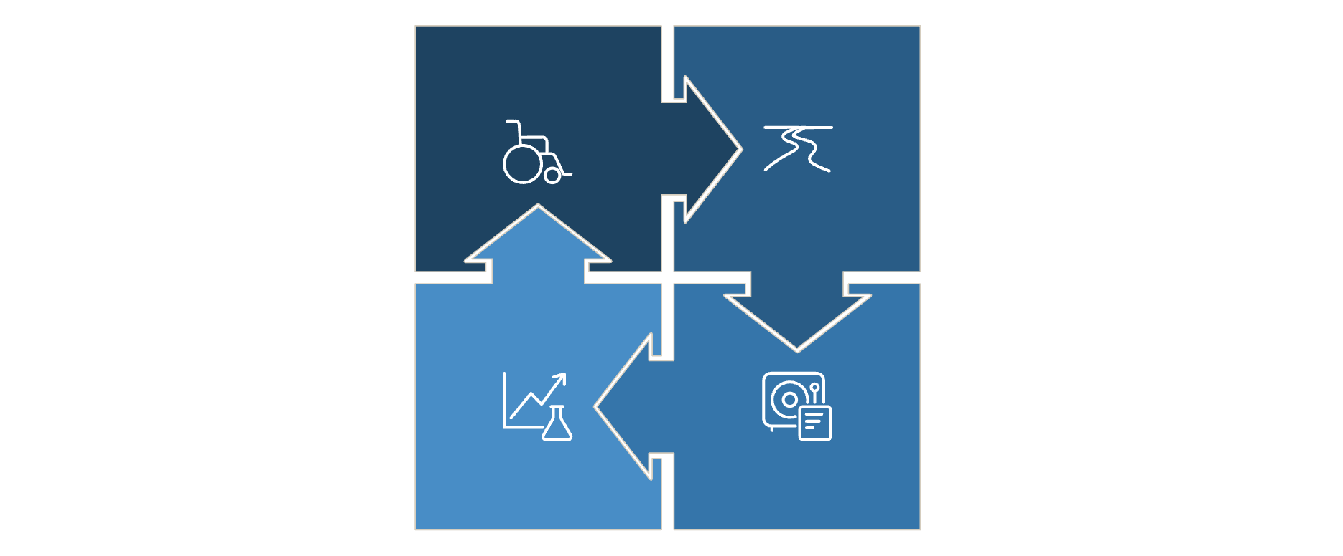





How Multi-Database Strategy Integrates with Real-Time Architecture
Uber's data infrastructure is a sophisticated ecosystem where real-time stream processing acts as the central nervous system, intelligently routing and transforming data across a specialized array of databases. Each database is chosen for its unique strengths, ensuring optimal performance, integrity, and scalability across the platform.
Data Sources
Stream Processing
Applications & Analytics
Multi Databases
Specialized Database Roles in Action
Redis: Hot Storage (Millisecond Access)
PostgreSQL: Transactional (Accuracy & Consistency)
What: Current driver locations, active rider requests, surge pricing, user sessions.
What: User accounts, payment records, trip bookings, driver profiles.
Why: Demands ACID compliance (Atomicity, Consistency, Isolation, Durability) for financial and critical data.
Why: Requires instant access and <1ms latency for real-time interactions.
How: Relational database with strong consistency guarantees.
How: In-memory storage for extremely fast reads/writes.
Example: Every payment transaction is recorded here to prevent monetary discrepancies.
Example: When a rider opens the app, their nearby drivers' locations are instantly retrieved.
Lifespan: Permanent (critical business data).
Lifespan: Hours to days (temporary, frequently accessed data).
Cassandra: Warm Storage (High Throughput)
Hadoop/Hive: Cold Storage (Historical Analysis)
What: GPS location history, trip events, sensor readings, user interactions.
What: Complete trip history, aggregated statistics, ML training data.
Why: Provides cost-effective storage for petabytes of historical data for long-term analysis.
Why: Built to handle millions of writes per second without performance degradation.
How: Distributed file system optimized for batch processing of large datasets.
How: Distributed NoSQL database, horizontally scalable across many servers.
Example: Analyzing five years of trip data to identify long-term demand trends by city segment.
Example: Millions of GPS updates from active drivers are continuously written to Cassandra.
Lifespan: Months to years (permanent archive).
Lifespan: Days to weeks (recent data for quick access and analysis).
Data Flow Example: A Complete Rider Request
1
Rider App Interaction
Rider opens app: Location data, destination input sent to Stream Processing.
2
Real-time Display
Stream Processor routes nearby driver locations to Redis for instant display on the rider's map.
3
Recent History Logging
Simultaneously, location data is also sent to Cassandra for a short-term, high-volume activity log.
4
Transaction Record
Trip booking details (fare, driver, rider, route) are securely stored in PostgreSQL upon confirmation.
5
Long-term Archiving
At the end of the day, trip data from Cassandra and PostgreSQL is archived into Hadoop/Hive for long-term storage.
Insights & Feedback
6
Analytics teams query Hadoop to understand demand patterns, feeding insights back to Stream Processing to refine surge pricing models and driver dispatch logic.
Why This Multi-Database Approach Matters
Redis
<1ms
Millions
Hours-Days
Caching, Real-time state
High
PostgreSQL
5-100ms
Thousands
Permanent
Transactional, User data
Medium
Cassandra
5-50ms
Millions
Days-Weeks
Time-series, Event logs
Low-Medium
Hadoop/Hive
Seconds-Minutes (Batch)
Billions (Batch)
Months-Years
Big Data Analytics, ML Training
Very Low
Performance: Each database is purpose-built and optimized for its specific data type and access pattern.
Reliability: Critical data like payments benefit from the robust ACID compliance of relational systems.
Scalability: The distributed nature of many systems allows handling millions of events per second and petabytes of data.
Cost-Efficiency: Hot, transient data resides in expensive in-memory stores, while massive archives use cost-effective storage solutions.
Flexibility: New data types or business requirements can be met by integrating new specialized databases without overhauling the entire architecture.

